Slide 1
The Woodwind Family

Slide 2
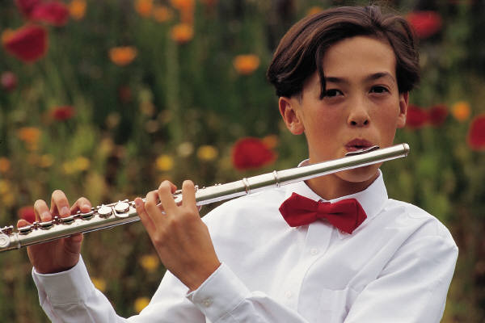
Positive Examples
Flute
Negative
Examples

Slide 3
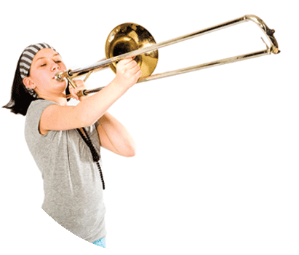
Positive Examples
Flute
Negative
Examples
Trombone

Slide 4
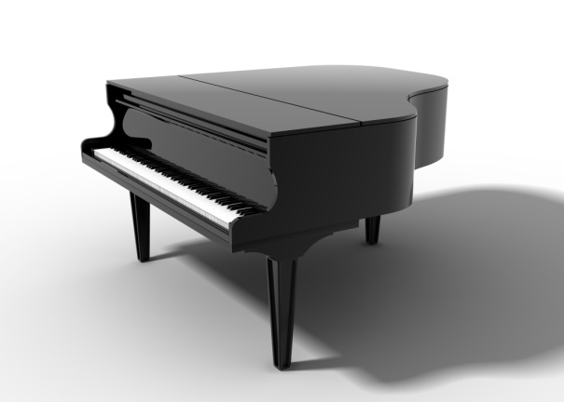
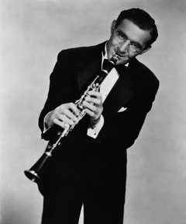
Positive Examples
Flute
Negative
Examples
Trombone
Clarinet
Piano

Slide 5
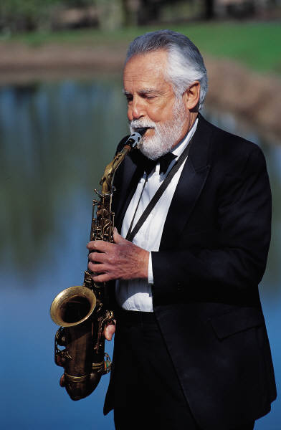
Positive Examples
Flute
Negative
Examples
Trombone
Clarinet
Piano
Saxophone

Slide 6
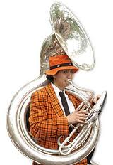
Positive Examples
Flute
Negative
Examples
Trombone
Clarinet
Piano
Saxophone
Sousaphone

Slide 7
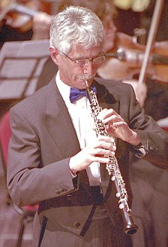
Positive Examples
Flute
Negative
Examples
Trombone
Clarinet
Piano
Saxophone
Oboe
Sousaphone

Slide 8
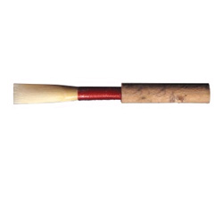
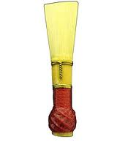
Oboe Double-Reed
Clarinet
Single-Reed
Bassoon Double-Reed

Slide 9
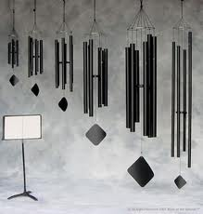
Positive Examples
Flute
Negative
Examples
Trombone
Clarinet
Piano
Saxophone
Sousaphone
Oboe
Wind
chimes

Slide 10
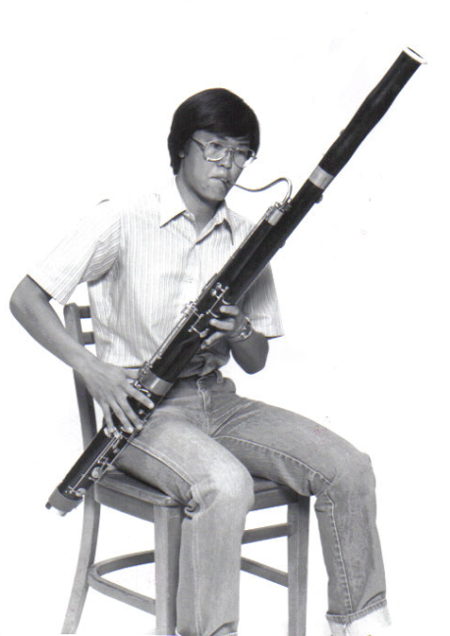
Positive Examples
Flute
Negative
Examples
Trombone
Clarinet
Piano
Saxophone
Oboe
Bassoon
Sousaphone
Wind chimes

Slide 11
Citations
Images
Oboe - http://news.bbcimg.co.uk/media/images/49493000/jpg/_49493810_49493809.jpg.
Clarinet -Corbis (Producer). (2006). Benny Goodman Playing Clarinet. [Image]. Available from http://www.discoveryeducation.com.
Bassoon - http://upload.wikimedia.org/wikipedia/commons/9/95/Bassoon_(PSF).png
Sousaphone - http://t0.gstatic.com/images?q=tbn:ANd9GcSG-Y0LvlJuc7DJr1b0Mun_VbM3ChRlGi-
Wind Chime - http://site.olivebarn.com/mots/images/chime_family_01.jpg
Double and single reeds - http://www.phys.unsw.edu.au/jw/clarinetacoustics.html, oboe-rohr-waagerecht.png, https://munciemusic.com/shop/images/uploads/bassoon%20reed.jpg
All others are MS office clip-art.
Sound Clips
Flute, Oboe, Clarinet, Bassoon, Tuba and Trombone sound clips from Boise Philharmonic Children’s Concerts: Instructional CD (2002).
Flute; J. Rampal, soloist – W.A. Mozart, Andante for Flute and Orchestra,
Oboe; H. Gomberg, soloist – G. Bizet, Symphony No. 1, Mvt. II,
Clarinet; E. Ottensamer, soloist – W.A. Mozart, Concerto in A Major,
Bassoon; – L. Glickman, soloist – S. Prokofiev, Peter and the Wolf,
Trombone - Baltimore Symphony, Rodeo - Buckaroo Holiday; A. Copland.
Tuba; Michael Lind, soloist - Concerto for Tuba and Orchestra; V. Williams.
All others from MS Office Clipart
Narration – Trudi Clark-Cochrane
Created by Trudi Clark-Cochrane, Meridian Joint School District No. 2, 2012

