Slide 1
The String Family

Slide 2
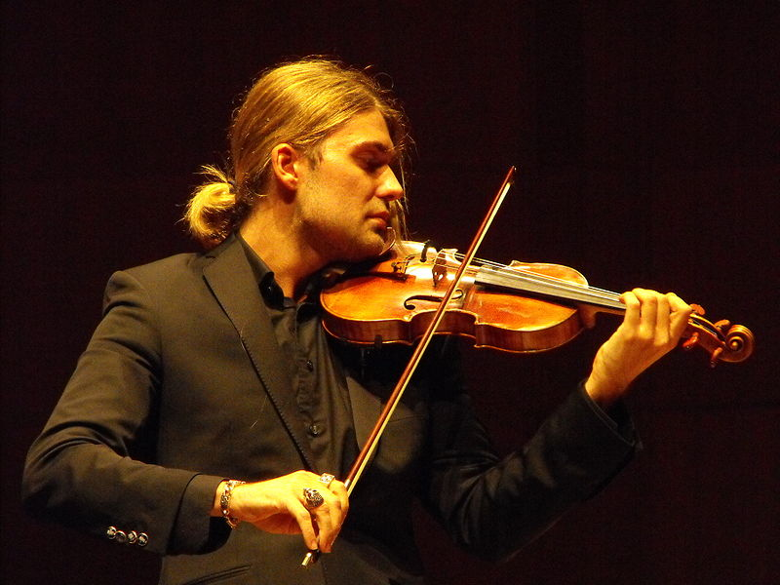
Positive
Examples
Negative
Examples
Violin

Slide 3
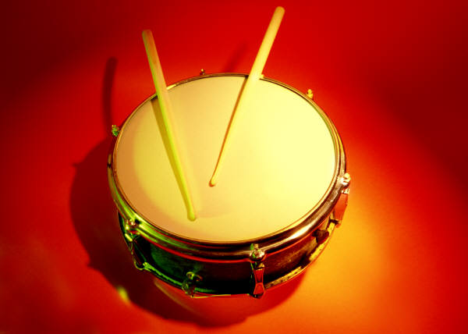
Positive
Examples
Negative
Examples
Violin
Snare Drum

Slide 4
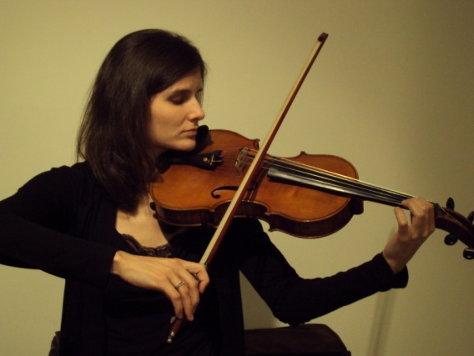
Positive
Examples
Negative
Examples
Violin
Snare Drum
Viola

Slide 5
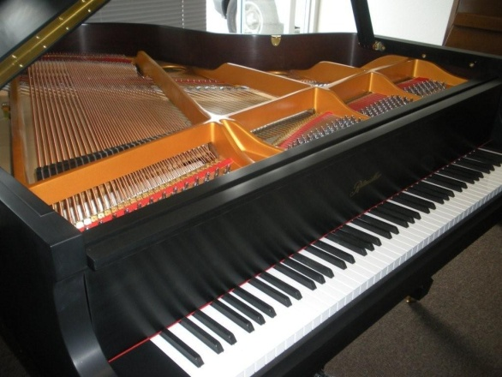
Positive
Examples
Negative
Examples
Violin
Snare Drum
Viola
Piano

Slide 6
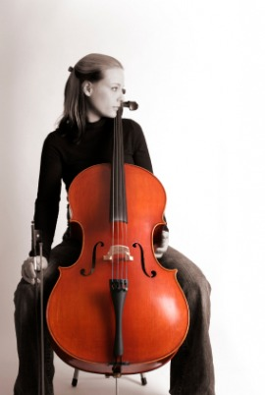
Positive
Examples
Negative
Examples
Violin
Snare Drum
Cello
Viola
Piano

Slide 7
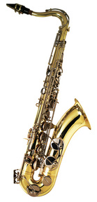
Positive
Examples
Negative
Examples
Violin
Snare Drum
Cello
Viola
Piano
Saxophone

Slide 8
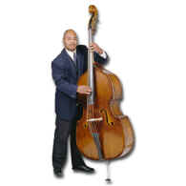
Positive
Examples
Negative
Examples
Violin
Snare Drum
Cello
Viola
String
Bass
Piano
Saxophone

Slide 9
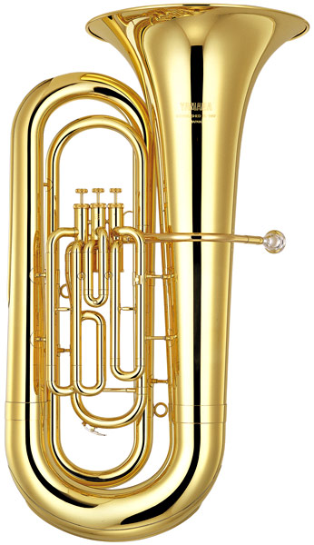
Positive
Examples
Negative
Examples
Violin
Snare Drum
Cello
Viola
String
Bass
Piano
Saxophone
Tuba

Slide 10
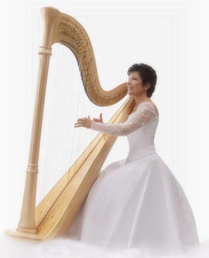
Positive
Examples
Negative
Examples
Violin
Snare Drum
Cello
Viola
String
Bass
Piano
Harp
Saxophone
Tuba

