Slide 1
The Percussion Family

Slide 2
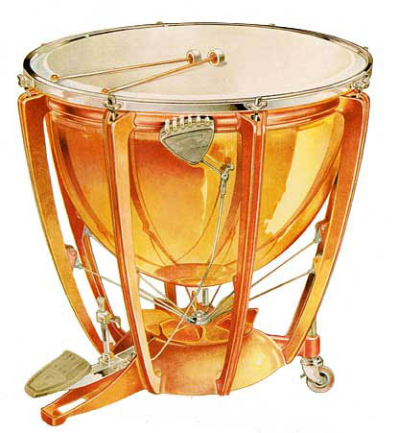
Positive Examples
Negative
Examples
Timpani
Pitched
Strike

Slide 3
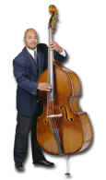
Positive Examples
Negative
Examples
Timpani
Pitched
Strike
String Bass

Slide 4
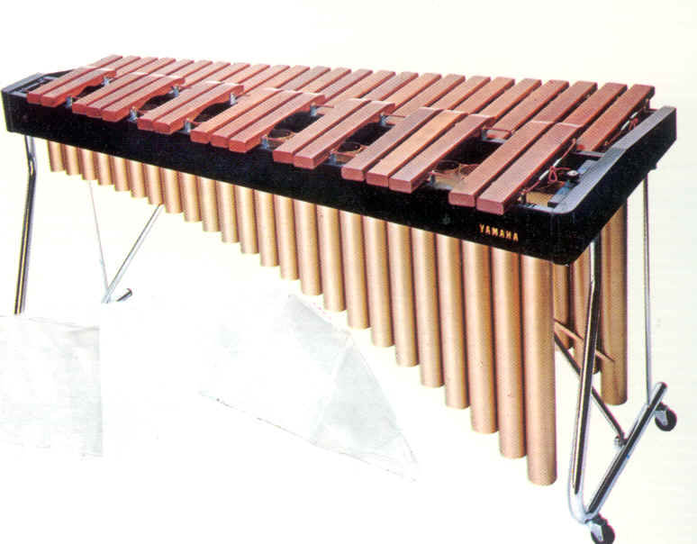
Positive Examples
Negative
Examples
Timpani
Pitched
Strike
String Bass
Xylophone
Pitched
Strike

Slide 5
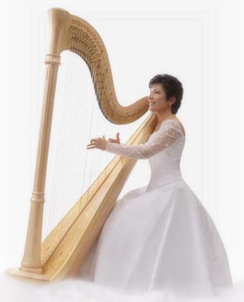
Positive Examples
Negative
Examples
Timpani
Pitched
Strike
String Bass
Xylophone
Pitched
Strike
Harp

Slide 6
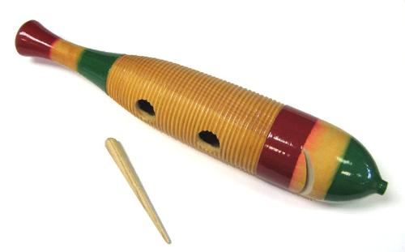
Positive Examples
Negative
Examples
Timpani
Pitched
Strike
String Bass
Xylophone
Pitched
Strike
Harp
Guiro
Unpitched
Scrape

Slide 7
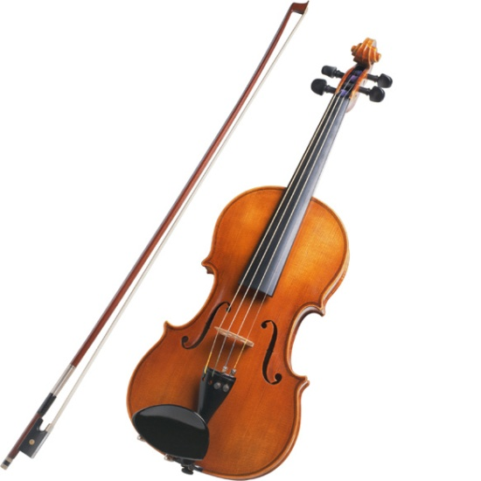
Positive Examples
Negative
Examples
Timpani
Pitched
Strike
String Bass
Xylophone
Pitched
Strike
Harp
Guiro
Unpitched
Scrape
Violin

Slide 8
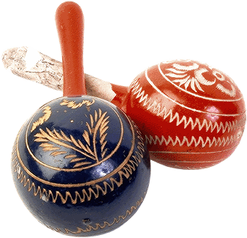
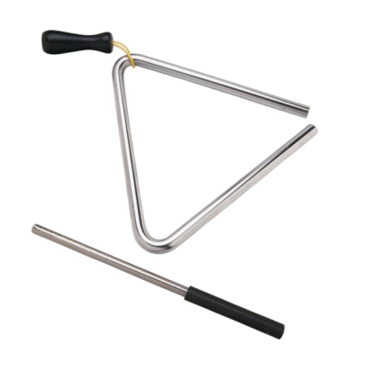
Positive Examples
Negative
Examples
Timpani
Pitched
Strike
String Bass
Xylophone
Pitched
Strike
Harp
Guiro
Unpitched
Scrape
Maracas
Unpitched
Shake
Triangle
Unpitched
Strike
Violin

Slide 9
Citations
Images
Timpani - http://tmo2000c.ipower.com/instruments/photos/timpani.jpg
Xylophone - http://library.thinkquest.org/05aug/01803/xylophone.jpg
Triangle - http://www.buzzle.com/images/musical-instruments/percussion-instruments-triangle.jpg
Maracas – http://www.musicwithease.com/maracas-6.gif
Guiro - http://www.quia.com/files/quia/users/amwestenberg/Guiro
String Bass - http://www.grahamnasby.com/misc/images_concertband/string-bass.jpg
Harp – Joanna Mell http://www.joannamell.com/assets/images/harp_joanna_mell_white_dress.jpg
Violin - http://www.encoremusiclessons.com/images/about_page_imgs/violin-lg.jpg
Sound Samples - Taken from Boise Philharmonic Children’s Concert; Sample CD, 2002.
Timpani – March for Kettledrums, Played by Nexus Ensemble, Jacques Philidor, composer.
String Bass – Carnival of the Animals “The Elephant”, Played by Gabin Louridon, C. Saint-Saens, Composer.
Xylophone – Bolero – Spanish Dance No. 5, Played by Nexus Ensemble, M. Moszkowsky, Composer.
Triangle and Maracas - Unknown.
Harp – Concerto for Harp and Orchestra, Played by Nicanor Zabaleta, F. Boieldieu, Composer.
Guiro - Guiro’s, Played by Sound effects, Special FX2.
Violin – Microsoft Office Sound Samples
Narration – Trudi Clark-Cochrane
Created by Trudi Clark-Cochrane, Meridian Joint School District No. 2, 2012

