Slide 1
Keyboard Family

Slide 2
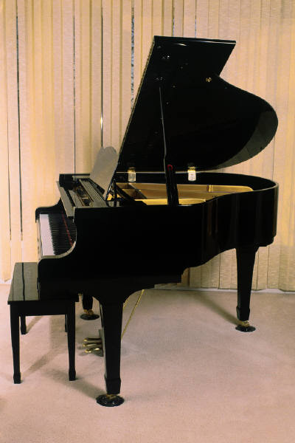
Positive Examples
Negative
Examples
Piano

Slide 3
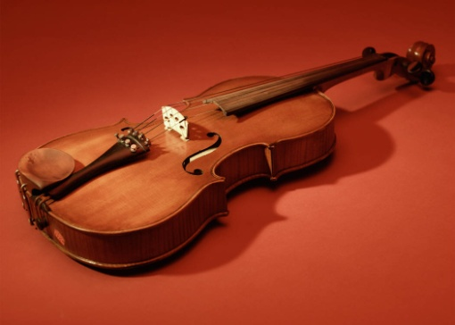
Positive Examples
Negative
Examples
Piano
Violin

Slide 4
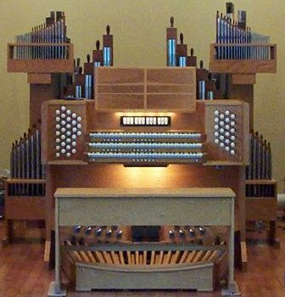
Positive Examples
Negative
Examples
Piano
Organ
Violin

Slide 5
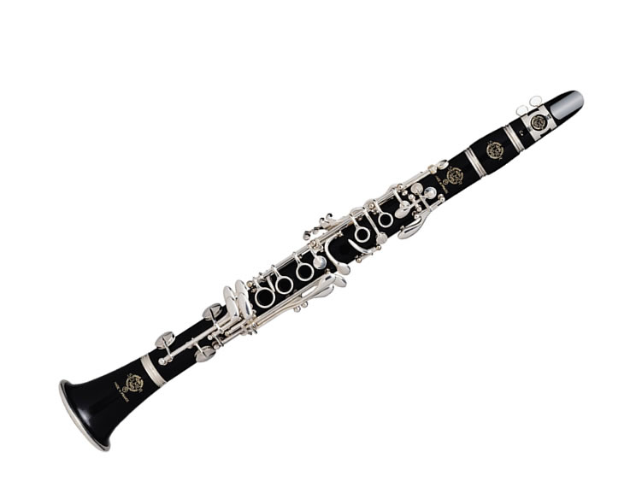
Positive Examples
Negative
Examples
Piano
Organ
Violin
Clarinet

Slide 6
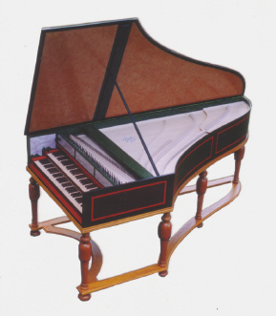
Positive Examples
Negative
Examples
Piano
Organ
Violin
Clarinet
Harpsichord

Slide 7
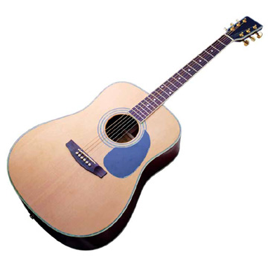
Positive Examples
Negative
Examples
Piano
Organ
Violin
Guitar
Clarinet
Harpsichord

Slide 8
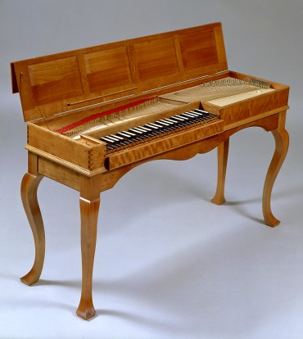
Positive Examples
Negative
Examples
Piano
Organ
Violin
Guitar
Clarinet
Harpsichord
Clavichord

Slide 9
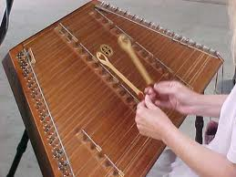
Positive Examples
Negative
Examples
Piano
Organ
Violin
Guitar
Clarinet
Harpsichord
Clavichord
Hammered Dulcimer

Slide 10
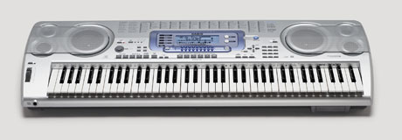
Positive Examples
Negative
Examples
Piano
Organ
Violin
Guitar
Clarinet
Harpsichord
Clavichord
Hammered Dulcimer
Digital Piano

Slide 11
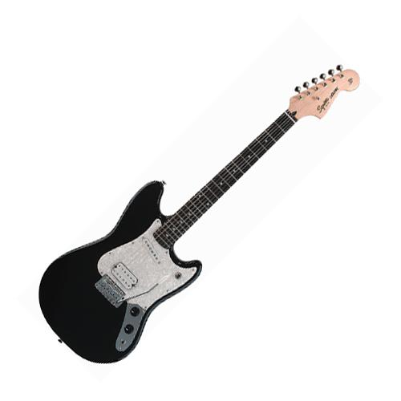
Positive Examples
Negative
Examples
Piano
Organ
Violin
Guitar
Clarinet
Harpsichord
Clavichord
Hammered Dulcimer
Digital Piano
Electric Guitar

Slide 12
Citations
Images
Piano and violin are MS Office clip art.
Pipe organ http://www.google.com/imgres?q=pipe+organ&num=10&hl=en&biw=1249&bih=558&tbm=isch&tbnid=GEueJCgn2YN2yM:&imgrefurl=http://www.haskey.com/johnh/organ/organ.html&docid=PKXDTWh1bw35kM&imgurl=http://haskey.com/johnh/organ/console_only.jpg&w=336&h=350&ei=vsjwT8CKN4XKqgHi1YmOAg&zoom=1&iact=hc&vpx=987&vpy=2&dur=185&hovh=229&hovw=220&tx=149&ty=104&sig=102949387644981406920&page=2&tbnh=160&tbnw=181&start=12&ndsp=19&ved=1t:429,r:5,s:12,i:196
Harpsichord - http://www.google.com/imgres?q=harpsichord&um=1&hl=en&sa=N&rlz=1T4TSNF_enUS424US425&biw=1249&bih=558&tbm=isch&tbnid=Oe2KkO7VvyPjiM:&imgrefurl=http://www.lautenwerk.com/&docid=zU7IR2jG8buddM&imgurl=http://www.lautenwerk.com/images_harpsichords/lautenwerk_harpsichord.jpg&w=289&h=331&ei=m8nwT-epI4nxqAGQnLT9AQ&zoom=1&iact=hc&vpx=499&vpy=2&dur=94&hovh=240&hovw=210&tx=100&ty=119&sig=102949387644981406920&page=1&tbnh=165&tbnw=176&start=0&ndsp=12&ved=1t:429,r:8,s:0,i:166
Clavichord - http://www.google.com/imgres?q=clavichord&start=100&um=1&hl=en&sa=N&qscrl=1&nord=1&rlz=1T4TSNF_enUS424US425&biw=1249&bih=558&addh=36&tbm=isch&tbnid=cF_tZmnJM_zGDM:&imgrefurl=http://www.ateliermarcducornet.com/new/en/md.html&docid=3jsnADQXuDd0GM&imgurl=http://www.ateliermarcducornet.com/new/im/instruments/md/hubert.jpeg&w=370&h=414&ei=rMrwT-jKJpPVrQHeobyNAg&zoom=1&iact=hc&vpx=107&vpy=170&dur=2528&hovh=238&hovw=212&tx=145&ty=140&sig=102949387644981406920&page=8&tbnh=176&tbnw=149&ndsp=16&ved=1t:429,r:5,s:100,i:71
Digital Piano- http://2.bp.blogspot.com/-fLgkjrxyK7k/TcwHPvRZROI/AAAAAAAAAwA/STHo1vPoWqI/s1600/acoustic_guitar.jpg
Clarinet - http://1.bp.blogspot.com/-LfX6nETd5HA/TrcvstNlzUI/AAAAAAAAAkw/6j_pr2B3fZ0/s1600/clarinet.jpg
Guitar - http://2.bp.blogspot.com/-fLgkjrxyK7k/TcwHPvRZROI/AAAAAAAAAwA/STHo1vPoWqI/s1600/acoustic_guitar.jpg
Hammered dulcimer - http://people.delphiforums.com/SIGN543/Dulcimer_hands.jpg
Electric guitar - http://www.mpsaz.org/skyline/staff/tcbender/class4/images/electric_guitar.jpg
Sound Samples
Organ - Toccata in d minor – by Albert Renaud; found at http://www.nzorgan.com/sounds/sounds.htm.
Harpsichord - py of Hemsch 1754 (Chapelin-Dubar, Koch 310.043 #20) found at http://www-personal.umich.edu/~bpl/hpsi.html
Clavichord - 18th C Austro-German style (Leonhardt, Philips 422.349 #10) found at http://www-personal.umich.edu/~bpl/hpsi.html
Hammered Dulcimer - http://larkinam.com/HammeredDulcimers.html
Clarinet - E. Ottensamer, soloist – W.A. Mozart, Concerto in A Major; taken from Philharmonic Children’s Concert, Instructional CD 2002.
All others are MS Office clip art sounds.
Narration by Trudi Clark-Cochrane
Created by Trudi Clark-Cochrane, Meridian Joint School District #2, 2012

