Slide 1
The Brass Family

Slide 2
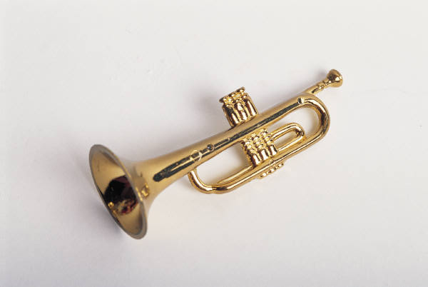
Positive Examples
Negative Examples
Trumpet

Slide 3
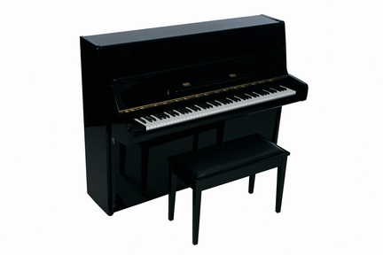
Positive Examples
Negative Examples
Trumpet
Piano

Slide 4
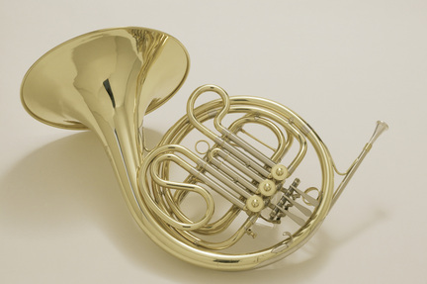
Positive Examples
Negative Examples
Trumpet
Piano
French Horn

Slide 5
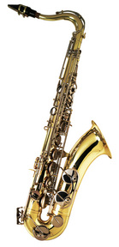
Positive Examples
Negative Examples
Trumpet
Piano
French Horn
Saxophone

Slide 6
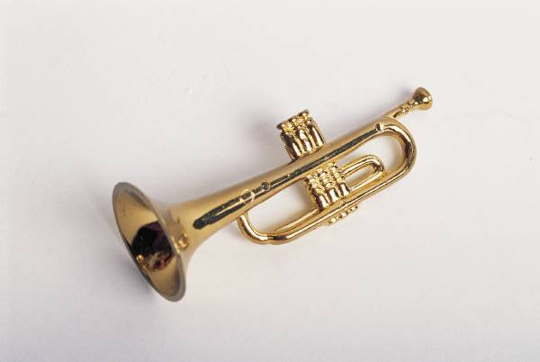
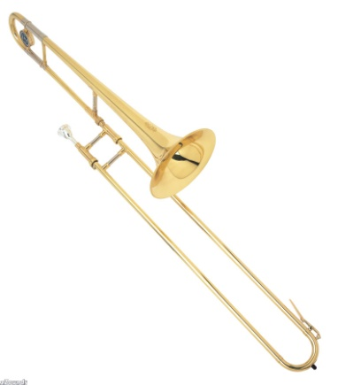
Positive Examples
Negative Examples
Trumpet
Piano
French Horn
Saxophone
Trombone

Slide 7
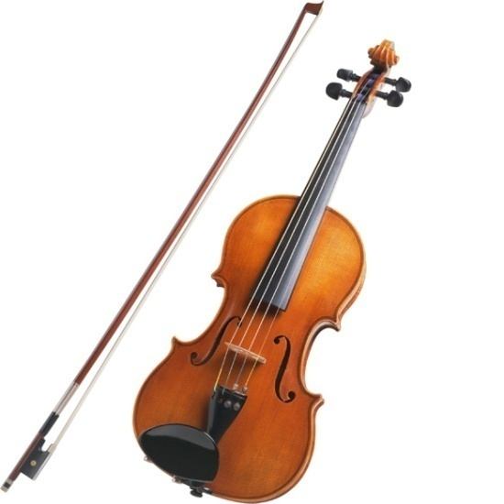
Positive Examples
Negative Examples
Trumpet
Piano
French Horn
Violin
Saxophone
Trombone

Slide 8
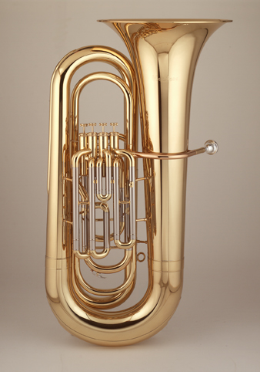
Positive Examples
Negative Examples
Trumpet
Piano
French Horn
Violin
Trombone
Saxophone
Tuba

Slide 9
Citations
Images
Trumpet – MS PowerPoint Clip Art
French Horn -Jupiterimages Corporation (Producer). (2006). French Horn (2). [Image]. Available from http://www.discoveryeducation.com/
Trombone - http://www.leadmineband.com/pix/trombone.jpg
Tuba - http://www.music.vt.edu/musicdictionary/textt/images/tuba.jpg
Piano - Jupiterimages Corporation (Producer). (2006). Upright Piano. [Image]. Available from http://www.discoveryeducation.com/
Saxophone - Jupiterimages Corporation (Producer). (2006). Saxophone. [Image]. Available from http://www.discoveryeducation.com/
Violin - http://www.encoremusiclessons.com/images/about_page_imgs/violin-lg.jpg
Instrument Sound clips
Horn sound clip - http://www.michaelthompson.uk.com/audio/fragment2.mp3
Tuba and Trombone sound clips from Boise Philharmonic Children’s Concerts: Instructional CD (2002). Trombone; Baltimore Symphony, Rodeo; Buckaroo Holiday; Aaron Copland. Tuba; Michael Lind, Concerto for Tuba and Orchestra; V. Williams.
All other sound clips from MS PowerPoint clip art.
Narration – Trudi Clark-Cochrane
Created by Trudi Clark-Cochrane, Meridian Joint School District No. 2, 2012

